Slide 1
Suffixes
At the end of a word to modify

Slide 2
“Pertaining to” Suffixes
-ac cardiac pertaining to the heart
-al renal pertaining to the kidney
-an ovarian pertaining to the ovary
-ar lumbar pertaining to lower back
-ary alimentary pertaining to the GI tract

Slide 3
-eal laryngeal pertaining to larynx
-ic enteric pertaining to intestines
-ine uterine pertaining to uterus
-ous cutaneous pertaining to the skin
-tic nephrotic pertaining to the kidneys

Slide 4
COMBINING VOWELS
Vowels are used to “combine” medical terms to make them easier to pronounce.
“O” is the most commonly used combining vowel
(however, “i” and “e” may be used as well.)
The combining vowel is used when the suffix begins with a consonant.
Example:
-scope is a suffix, begins with a consonant. Arthr|o|scope “O” is the combing vowel

Slide 5
A combining vowel is not used when a suffix begins with a vowel.
Example:
-itis is a suffix, begins with a vowel
Athr|itis no combining vowel
Another example: Gastr|itis (no combining vowel)

Slide 6
Bell work Monday Sept. 9
1. Intracardiac
a. Prefix/Definition
b. Root/Definition
c. Suffix/Definition
d. What does Intracardiac mean?
2. Adrenal
a. Prefix/Definition
b. Root/Definition
c. Suffix/Definition
d. What does Adrenal mean?

Slide 7
Surgical Suffixes
-pexy suture to stabilize gastropexy
(surgically stabilizing the stomach to the abdominal wall)
-ectomy surgical removal mastectomy
(surgical removal of the mammary glands)
-plasty surgical repair rhinoplasty
(surgical repair of the nose)

Slide 8
-stomy surgically created opening colostomy
surgically created opening between the colon and body surface
-tomy cutting into laparotomy
an incision / cutting into the abdomen
-scopy visual examination with a “scope” colonoscopy
visual examination with a scope of the colon
-logy study of histology
study of tissue

Slide 9
Pay attention!
-tomy………cutting into or an incision
-ectomy……..surgical removal or excision
Lobotomy vs. Lobectomy
…just saying ☺

Slide 10
More words
Colo (also colono) - colon (large intestine)
colonoscopy
Laparo - abdominal wall, abdomen
laparotomy
Histo – tissue
histology
Cyto - cell
cytology
Reno – kidney
renal
Arthro…….joint
Gastro…….stomach
Osteo……..bone
hema……..blood
hepa……...liver
Nephro……kidney
Cardio…….heart
neuro…….nerve
oto……….ear
optho…….eye
myo……...muscle
thoraco…..ribs
entero……intestine
myelo……nerve, spinal cord
derm……..skin
pneumo….lungs or air
cephalo…..brain
cysto……..bladder
podo……..foot
pyo………pus
rhino…….nose

Slide 11
Bell Work Tuesday Sept 10
“Cyan” is a root word meaning “blue discoloration”
Define the following words:
Cyanosis
Cyanotic
What function does the “o” perform?
Define the following:
Gastrotomy
Gastrostomy
Gastrectomy
Why is there no “o” in the last word?

Slide 12
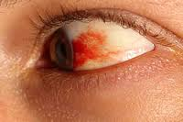
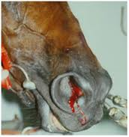
Double “R” Suffixes
-rrhagia or -rrhage
bursting forth
hemorrhage
(bursting forth of blood from vessels)
-rrhaphy to suture
enterorrhaphy
suturing of the intestines)
Conjunctival hemorrhage
exercise induced pulmonary hemorrhage

Slide 13
-rrhea
flow, discharge
diarrhea (complete discharge of the bowels.)
-rrhexis
rupture
myorrhexis (rupture of the muscle)

Slide 14
More about combining vowels
A combining vowel is always used when two or more root words are joined.
Gastr/o (stomach) is joined with Enter/o (small intestine) = Gastroenteritis
(note the anatomical order)
A combining vowel is not used between a prefix and the root word

Slide 15
Making medical terms plural
-ae usually pronounced “ee”
one fascia--- two fasciae
definition: a sheet of connective tissue covering or binding together body structures (such as muscles)
-i usually pronounced long “i”
one glomerulus--- two glomeruli
the plural is made by dropping “us” and adding “i”
definition: a small convoluted or intertwined mass (as of organisms, nerve fibers, or capillaries)

Slide 16
Procedural Suffixes
-centesis withdraw fluid from
cystocentesis, thoracentesis
-gram record of
electrocardiogram
-graph instrument that makes the record electrocardiograph
-lysis separation or breakdown
urinalysis
-scope instrument to visually examine with
endoscope, arthroscope
-therapy treatment
chemotherapy

Slide 17
Structural Suffixes
-itis inflammation of hepatitis, cystitis, iritis
-malacia abnormal softening osteomalacia
-megaly enlargement of cardiomegaly
-osis abnormal condition cyanosis
-pathy disease or problem cardiomyopathy
-sclerosis abnormal hardening arteriosclerosis
-um structure pericardium

Slide 18
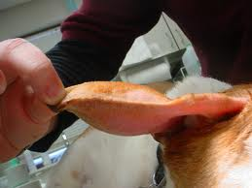
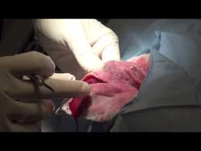
Other common medical suffixes
-oma swelling or mass
hematoma, hepatoma, seroma
-ology study of
microbiology, virology, immunology
-emia blood
anemia, uremia, hypoglycemia
-uria urine
hematuria

Slide 19
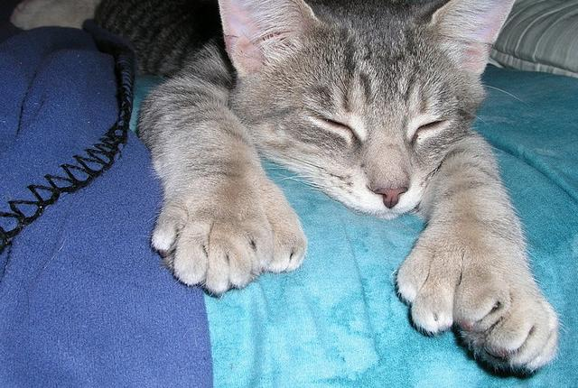
-dactyl digit polydactyl
The Ernest Hemingway Home and Museum is home to approximately 40-50 polydactyl (six-toed) cats.
-dypsia drinking or thirst polydypsia

Slide 20
-phagia swallowing dysphagia
-ocia birth dystocia
-itis inflammation conjunctivitis
-osis abnormal condition cardiosis
END

Slide 21
Dissect the word - divide it into parts
Suffix, prefix, root (body)
Root words:
Left to right: If there are two root words read/analyze them from left to right
Anatomically: Body systems are are placed together in the order they occur
gastrointestinal (stomach before intestines)
ovariohysterectomy (ovaries before uterus)
(-ectomy – removal)
(hysterio – uterus)

Slide 22
Bell Work Wednesday, Sept 11
Polyarthritis
Identify the suffix, what does it mean
Identify the prefix, what does it mean
Identify the root word, what does it mean
What does the word polyarthritis mean?
Onychectomy
The word onych/o means nail or claw…is onych a prefix, suffix or root word?
What does the word mean?
What is the “non-medical” word for this in the veterinary clinic?

Slide 23
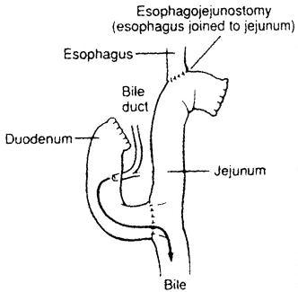
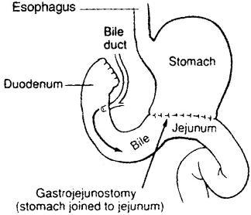
Because you asked…
gastrectomy

Slide 24
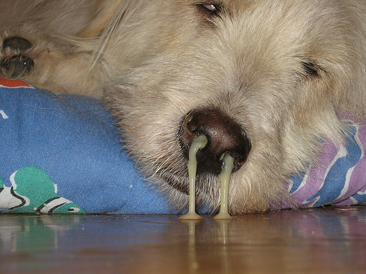
This is what you would call a real bad case of rhinorrhea.

Slide 25
Bell Work Thursday, Sept 12
A 5 year old male neutered cat is presented to a veterinary clinic with ________________(painful urination) and _______________________(scant urine production). The cat is found to have an obstruction of the urethra. The cat is anesthetized, and a urinary catheter is passed. Urine is collected for a ________________________(breakdown of urine into its components). In addition the cat is treated for
__________________________(inflammation of the urinary bladder.

Slide 26
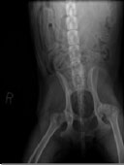
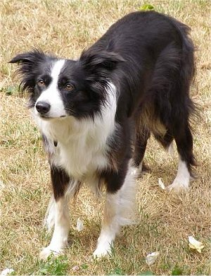
Bell Work Monday, Sept 16
Tyler, a neutered male 8-year old Border Collie, was brought into the clinic and was diagnosed with bilateral hip dysplasia.
Bi- means two
Lateral – directional term that means away from the “midline”
Dys – bad, painful, difficult,
abnormal
-plasia-development or
formation
midline
lateral

Slide 27
-logy, the study of
Physiology-study of how things function
Pathology-study of nature, causes, development of abnormal conditions
Pathophysiology-the study of changes in function caused by death
Etiology-the study of disease
Cytology-the study of cells
Histology-the study of tissues
Histopath (-path/o and –pathy mean disease)
Histopathology
-opsy (view of) Bi/o- (life) Biopsy

Slide 28
Bell Work Tuesday, Sept 17
"Maggie" was lethargic and anorexic for a few days. However, the owner complained that she was drinking and urinating a lot. "Maggie" had also been "in heat" last month
Approximately 50% of dogs with pyometritis present with polyuria / polydypsia. These renal manifestations are poorly understood but may result from prerenal azotemia secondary to dehydration and/or shock...
Azot/o- urea, nitrogen (a waste/ by product of inefficient filtering by the kidneys)
Metri/o - uterus

Slide 29
Afebrile
Epidermis
Ectoderm
Epidermis
Eupnea (-pnea = breathing)
Infraorbital
Intercostal (cost/o ribs)
Intraocular
Metacarpus
Percutaneos tracheostomy,
also percutaneous nephrostomy
polycystic

Slide 30
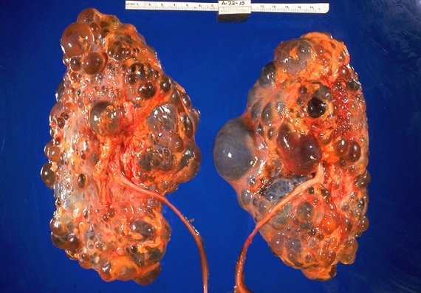
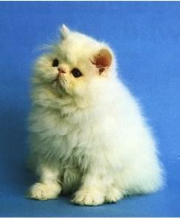
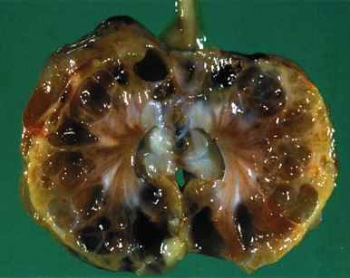
What is polycystic kidney disease?
Polycystic kidney disease is an inherited condition that causes multiple cysts (pockets of fluid) to form in the kidneys. These cysts are present from birth. They start out very small but they grow larger with time and may eventually severely disrupt the kidney; when that happens the kidney can no longer work and kidney failure develops. The cysts usually grow quite slowly, so most affected cats will not show any signs of kidney disease until relatively late in life, typically at around seven or eight years old, or even into older age. However, in some cats kidney failure will occur at a much younger age and at the moment there is no way of predicting how rapidly the disease will progress in any particular cat.
Polycystic kidneys

Slide 31
Seizures may be broadly categorized as having either an intracranial or extracranial cause.
Intracranial causes include tumors, encephalitis, hydrocephalus, trauma, hemorrhage, idiopathic epilepsy.
Extracranial causes include hypoglycemia, hypocalcemia, toxicosis, extracranial neoplasia.
Prefixes: Intra-, Extra-, hydro-, hypo-, neo- (new)
Suffixes: -al, -itis, -us, -rrhage, -ic, -emia, -osis, -ia (condition)
Root words (body): cran/o, cephal/o, hem/o, path/o
glyc/o, calc/o, toxic/o, plas/o

Slide 32
Did you get them all
Prefixes: Intra-, Extra-, hydro-, hypo-, neo- (new)
Suffixes: -al, -itis, -us, -rrhage, -ic, -emia, -osis, -ia (condition)
Root words (body): cran/o, cephal/o, hem/o, path/o
glyc/o, calc/o,
toxic/o, plas/o

